Slide 1

Lecture 1
Artificial Intelligence

Slide 2

A G E N D A
What is artificial intelligence?
History and Evolution of AI
Application of AI in various industries
Major AI Technologies
AI vs Machine Learning vs Deep Learning
Future Trends in AI

Slide 3



What is AI?
Wikipedia
Artificial intelligence (AI) is the intelligence exhibited by machines or software.
McCarthy
The science and engineering of making intelligent machines
Russel and Norvig AI book
The study and design of intelligent agents, where an intelligent agent is a system that perceives its environment and takes actions that maximize its chances of success.

Slide 4
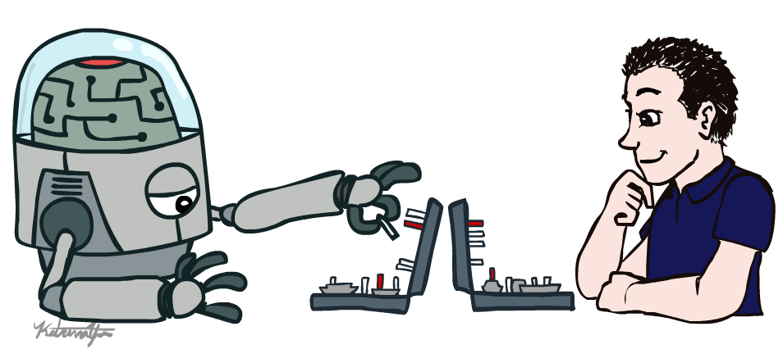
What is AI?
AI (Artificial Intelligence) is a machine’s ability to perform cognitive functions as humans do, such as perceiving, learning, reasoning, and solving problems. The benchmark for AI is the human level concerning in teams of reasoning, speech, and vision.

Slide 5

History and Evolution of AI
The Origin of Artificial Intelligence (1940s-1950s)
Turing and the "Turing Test":
Alan Turing, known as the father of computer science and the father of AI science, proposed the famous "Turing Test" in 1950. The test suggests that if a machine can answer a series of questions posed by a human tester within five minutes, and more than 30% of its answers mislead the tester into believing they were given by a human, then it passes the test. This test provides a standard for assessing whether a machine possesses intelligence.
The Birth of Artificial Intelligence:
In 1956, computer scientist John McCarthy coined the term "artificial intelligence" and formally established AI as a research discipline at a conference held at Dartmouth College. In the same year, McCarthy and Marvin Minsky co-founded the world's first AI laboratory, the MIT AI Lab.

Slide 6

History and Evolution of AI
The Golden Age of Artificial Intelligence (1950s-1970s)
The Development of Expert Systems:
From the 1960s to the 1970s, researchers began to develop expert systems that utilize knowledge bases and inference rules to solve problems in specific domains.
The Emergence of Industrial Robots:
In 1959, the world's first industrial robot was created by George Devol and Joseph Engelberger.

Slide 7
History and Evolution of AI
The Explosion of Deep Learning and Artificial Intelligence (2000s to Present)
The Rise of Deep Learning:
Entering the 21st century, with the advancement of big data and computing power, deep learning techniques have been widely applied. These techniques, based on statistical models and neural networks, can automatically learn from data and have achieved significant breakthroughs in image recognition, natural language processing, and other fields.
Widespread Applications of AI:
AI is now widely used in areas such as self-driving cars, voice assistants, intelligent robots, medical diagnosis, financial analysis, and has significantly changed people's lives and working methods.

Slide 8
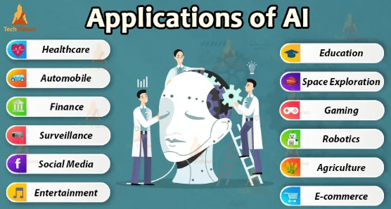
Applications of AI in various industries

Slide 9
Applications of AI in various industries
Healthcare: AI is used for medical diagnosis, drug discovery, and predictive analysis of diseases.
Finance: AI helps in credit scoring, fraud detection, and financial forecasting.
Retail: AI is used for product recommendations, price optimization, and supply chain management.
Manufacturing: AI helps in quality control, predictive maintenance, and production optimization.
Transportation: AI is used for autonomous vehicles, traffic prediction, and route optimization.
Customer service: AI-powered chatbots are used for customer support, answering frequently asked questions, and handling simple requests.
Security: AI is used for facial recognition, intrusion detection, and cybersecurity threat analysis.
Marketing: AI is used for targeted advertising, customer segmentation, and sentiment analysis.
Education: AI is used for personalized learning, adaptive testing, and intelligent tutoring systems.
This is not an exhaustive list, and AI has many more potential applications in various domains and industries.

Slide 10






Major AI Technologies
Machine Learning
Natural Language Processing (NLP)
Computer Vision
Robotics
Data Neural Networks
Expert Systems
Machine Learning: A subfield of AI that uses algorithms to enable systems to learn from data and make predictions or decisions without being explicitly programmed.
Natural Language Processing (NLP): A branch of AI that focuses on enabling computers to understand, interpret, and generate human language.
Computer Vision: A field of AI that deals with the processing and analysis of visual information using computer algorithms.
Robotics: AI-powered robots and automation systems that can perform tasks in manufacturing, healthcare, retail, and other industries.
Neural Networks: A type of machine learning algorithm modeled after the structure and function of the human brain.
Expert Systems: AI systems that mimic the decision-making ability of a human expert in a specific field.
Chatbots: AI-powered virtual assistants that can interact with users through text-based or voice-based interfaces.

Slide 11
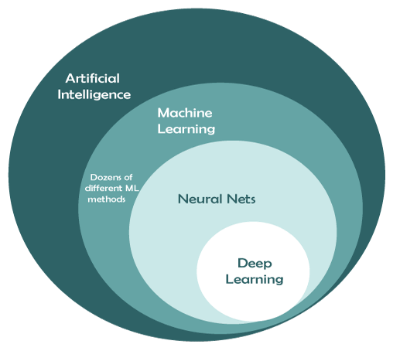
AI vs Machine Learning vs Deep Learning
Deep Learning, Machine Learning, and Artificial Intelligence are the most used terms on the internet for IT folks. However, all these three technologies are connected with each other. Artificial Intelligence (AI) can be understood as an umbrella that consists of both Machine learning and deep learning. Or We can say deep learning and machine learning both are subsets of artificial intelligence.﻿
As these technologies look similar, most of the persons have misconceptions about 'Deep Learning, Machine learning, and Artificial Intelligence' that all three are similar to each other. But in reality, although all these technologies are used to build intelligent machines or applications that behave like a human, still, they differ by their functionalities and scope.

Slide 12
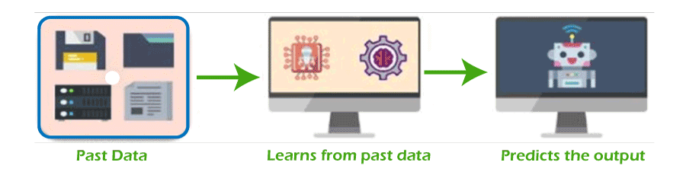
AI vs Machine Learning vs Deep Learning
What is Machine Learning?
Machine Learning is defined as the branch of Artificial Intelligence and computer science that focuses on learning and improving the performance of computers/machines through past experience by using algorithms.
AI is used to make intelligent machines/robots, whereas machine learning helps those machines to train for predicting the outcome without human intervention.

Slide 13
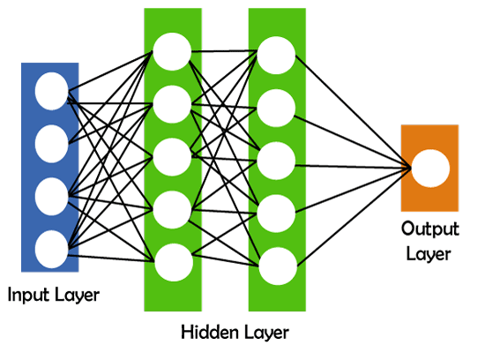
AI vs Machine Learning vs Deep Learning
What is Deep Learning?
"Deep learning is defined as the subset of machine learning and artificial intelligence that is based on artificial neural networks". In deep learning, the deep word refers to the number of layers in a neural network.
Deep learning can be useful to solve many complex problems with more accurate predictions such as image recognition, voice recognition, product recommendations systems, natural language processing (NLP), etc.

Slide 14
Future Trends in AI
Future Development Trends of Artificial Intelligence
The Development of Multimodal Models:
Future AI will focus more on the research of multimodal models to achieve the fusion understanding of text, images, and videos.
The Rise of Embodied Intelligence :
Embodied intelligence will become a new form of AI development, where intelligent agents can perceive the physical world from a protagonist's perspective and interact with the environment.
The Exploration of General Artificial Intelligence:
The path towards general AI is becoming increasingly clear, and the ways humans communicate with AI are constantly evolving.

